Slide 1
Rapid Manufacturing Technologies
Course code: MEE2016
Course Instructor
Dr. Senthil Kumar M.
School of Mechanical Engineering (SMEC)
VIT Chennai

Slide 2
Text books
I. Gibson l D. W. Rosen l B. Stucker, (2010), Additive Manufacturing Technologies: Rapid Prototyping to Direct Digital Manufacturing, Springer.
Chua C. K., Leong K. F., and Lim C. S., (2003), Rapid Prototyping: Principles and Applications, Second Edition, World Scientific Publishers.
Ma W. and Venuvinod P., Rapid Prototyping and Other Laser based processes, 2004, Kluwer Academic Press.

Slide 3
Other Reference Books
Peter D. Hilton, Hilton/Jacobs, Paul F. Jacobs, (2000), Rapid Tooling: Technologies and Industrial Applications, CRC Press.
Beaman, J. J. et al., (1997), Solid Freedom Fabrication, Kluwer.
Burns, M., (1993), Automated fabrication, Prentice-Hall.
Liou W. Liou, Frank W. Liou, (2007), Rapid Prototyping and Engineering applications: A Tool Box for Prototype Development, CRC Press.
Ali K. Kamrani, Emad Abouel Nasr, (2006), Rapid Prototyping: Theory and Practice, Springer.
Jacobs, P. F., (1996), Stereolithography and other RP&M technologies, ASME.

Slide 4
Mode of Evaluation
CAT 1 – 15 marks
CAT 2 – 15 marks
Assignments – (3x10) = 30 marks
FAT exam – 40 marks
Total = 100 marks
****************************
J-Component = 100 marks
Review 1 = 20 marks
Review 2 = 30 marks
Review 3 = 50 marks

Slide 5
Introduction

Slide 6
Introduction
Synonyms: Rapid manufacturing technology
Rapid prototyping technology
Solid freeform fabrication
Desktop manufacturing
Layer manufacturing technology
3D Printing
Additive Manufacturing
Notes:
Solid Freeform Fabrication is a set of manufacturing processes that are capable of producing complex freeform solid objects directly from a computer model of an object without part-specific tooling or knowledge.

Slide 7
What is rapid prototyping ?
Rapid prototyping (RP) technologies: It represents all the technologies that can construct three-dimensional physical objects directly from electronic data (CAD data).
Advantage: Builds a prototype in one step, directly from the geometric model of the part to be manufactured.
How does it happen? RP produces components in an additive manner by slicing the 3D-CAD model into a series of discrete layers. These layers are then reconstituted by the RP machine to produce a physical representation of the 3D-CAD model.
Rapid prototyping methods: examples
Stereolithography (SL)
Selective laser sintering (SLS)
3D printing (3DP)

Slide 8
What is rapid manufacturing?
Rapid Manufacturing (RM):
rapid manufacturing is the direct production of finished goods using a RP machine that eliminate tooling.
RM is making functional end products “directly” from CAD using additive technologies.
It is based on rapid prototyping processes and methods and consist in fast production of functional parts of small series.

Slide 9
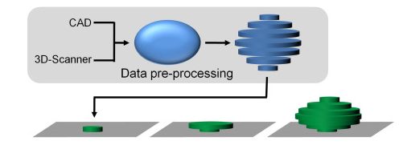
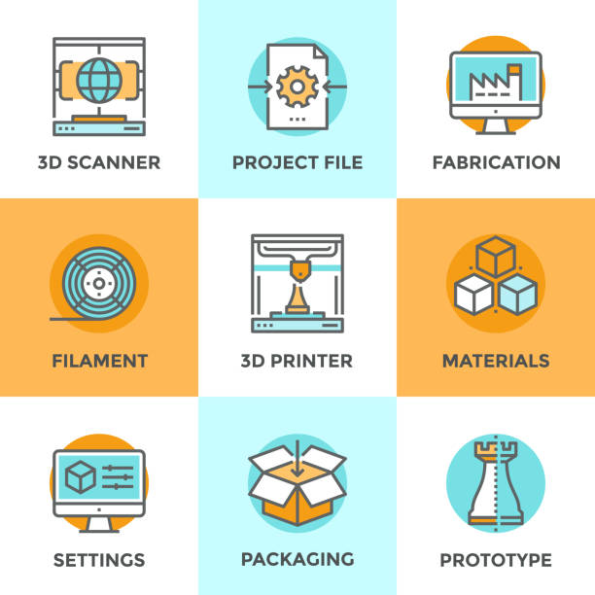
Rapid prototyping/Rapid manufacturing
Notes:
Slicing is an essential step in 3D printing that's characterized by the use of software to convert an object model into instructions for a 3D printer. The software essentially slices the object model into multiple layers. Each of these layers are then given values that denote the way in which it should be built.

Slide 10
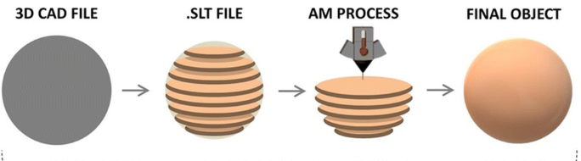
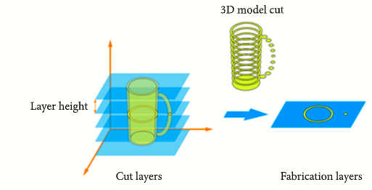

Slide 11
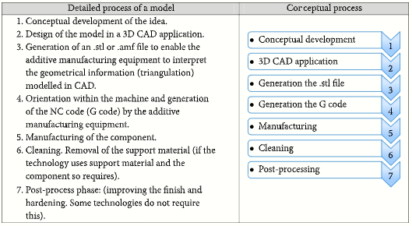
Detailed process

Slide 12
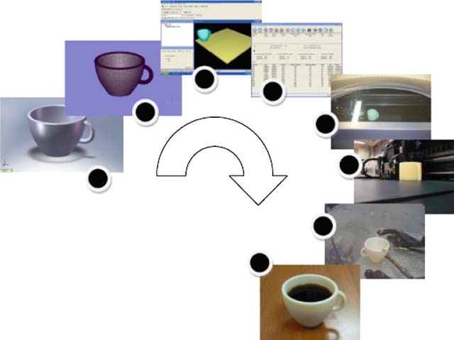
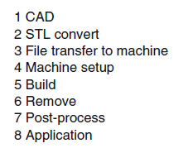
The Generic AM Process
Gibson et al.,

Slide 13
The Generic AM Process
Step 1: CAD
All AM parts must start from a software model that fully describes the external geometry.
This can involve the use of almost any professional CAD solid modeling software, but the output must be a 3D solid or surface representation.
Reverse engineering equipment (e.g. laser scanning) can also be used to create this representation.
Step 2: Conversion to STL
Nearly every AM machine accepts the STL file format, which has become a standard, and nearly every CAD system can output such a file format.
This file describes the external closed surfaces of the original CAD model and forms the basis for calculation of the slices.

Slide 14
The Generic AM Process
Step 3: Transfer to AM Machine and STL File Manipulation
The STL file describing the part must be transferred to the AM machine.
Here, there may be some general manipulation of the file so that it has the correct size, position, and orientation for building.
Step 4: Machine Setup
The AM machine must be properly set up prior to the build process.
Such settings would relate to the build parameters like the material constraints, energy source, layer thickness, timings, etc.

Slide 15
The Generic AM Process
Step 5: Build
Building the part is mainly an automated process and the machine can largely carry on without supervision.
Only superficial monitoring of the machine needs to take place at this time to ensure no errors have taken place like running out of material, power or software glitches, etc.
Step 6: Removal
Once the AM machine has completed the build, the parts must be removed.
This may require interaction with the machine, which may have safety interlocks to ensure for example that the operating temperatures are sufficiently low or that there are no actively moving parts.

Slide 16
The Generic AM Process
Step 7: Post-processing
Once removed from the machine, parts may require an amount of additional cleaning up before they are ready for use.
Parts may be weak at this stage or they may have supporting features that must be removed.
This therefore often requires time and careful, experienced manual manipulation.
Step 8: Application
Parts may now be ready to be used. However, they may also require additional treatment before they are acceptable for use.
For example, they may require priming and painting to give an acceptable surface texture and finish.
Treatments may be laborious and lengthy if the finishing requirements are very demanding.

Slide 17
The Generic AM Process
CAD image of a teacup with further images showing the effects of building using
different layer thicknesses

Slide 18
Historical development of RP and related technologies

Slide 19
Historical development of RP and related technologies
Reference: Chua C. K., Leong K. F., and Lim C. S., (2003), Rapid Prototyping: Principles and Applications, Second Edition, World Scientific Publishers

Slide 20
Additive Manufacturing: Need

Slide 21
Development of rapid prototyping systems

Slide 22
Rapid prototyping: Need

Slide 23
Additive Manufacturing Vs. CNC Technology

Slide 24
Distinction Between AM and CNC Machining
CNC differs mainly in that it is primarily a subtractive rather than additive process, requiring a block of material that must be at least as big as the part that is to be made.
CNC is likely to be a multistage manufacturing process, requiring repositioning or relocation of parts within one machine or use of more than one machine. CNC machines require considerable setup and process planning, particularly as parts become more complex in their geometry.
AM technology can be used to produce a part in a single stage.

Slide 25
Distinction Between RM and CNC Machining
Material
AM technology was originally developed around polymeric materials, waxes and paper laminates. Subsequently, there has been introduction of composites, metals, and ceramics.
CNC machining is particularly used for hard, relatively brittle materials like steels and other metal alloys to produce high accuracy parts with well defined properties.
Speed
High speed CNC machining can generally remove material much faster than RM machines can add a similar volume of material.
However, RM technology can be used to produce a part in a single stage while CNC machining is usually a multi-stage processing. Hence, Speed must therefore be considered in terms of the whole process rather than just the physical interaction of the part material.

Slide 26
Distinction Between AM and CNC Machining
Complexity
the higher the geometric complexity, the greater the advantage RM has over CNC.
Accuracy
AM machines generally operate with a resolution of a few tens of microns. It is common for RM machines to also have variable resolution along different orthogonal axes. Typically, the vertical build axis corresponds to layer thickness and this would be of a lower resolution compared with the two axes in the build plane.
The accuracy of CNC machines on the other hand is mainly determined by a similar positioning resolution along all three orthogonal axes and by the diameter of the rotary cutting tools.

Slide 27
Distinction Between AM and CNC Machining
Geometry
RM machines essentially break up a complex, 3D problem into a series of simple 2D cross-sections with a nominal thickness. In this way, the connection of surfaces in 3D is removed and continuity is determined by how close the proximity of one cross-section is with an adjacent one.
Since this cannot be easily done in CNC, machining of surfaces must normally be generated in 3D space.
Programming
Determining the program sequence for a CNC machine includes tool selection, machine speed settings, approach position, and angle, etc.
In the case of RM, complexity and implications surrounding their choice are minimal in comparison

Slide 28
Evolution of prototyping systems

Slide 29
Evolution of prototyping systems
First generation: Manual prototyping
Traditional (craft-based)
labor intensive
Second generation: Soft or virtual prototyping (Mid-1970s)
Application of CAD/CAE/CAM
Increasing complexity
Virtual prototype can be stressed, simulated and tested, with exact mechanical and other properties
Third generation: Rapid prototyping (Mid-1980s)
Solid freeform fabrication/Layer manufacturing
Benefit of a hard prototype made in a very short turnaround time is its main strong point (relies on CAD modeling)
Reference: Chua C. K., Leong K. F., and Lim C. S., (2003), Rapid Prototyping: Principles and Applications, Second Edition, World Scientific Publishers

Slide 30
Rapid Prototyping Vs. Virtual Prototyping

Slide 31
Rapid prototyping vs. Virtual prototyping
Rapid prototyping: The production of a physical model from a computer model without the need of any jig or fixture or NC programming.
Virtual prototyping: The subsequent manipulation of a solid CAD model as a substitute for a physical prototype for the purposes of simulation and analysis, and is not inclusive of the construction of the solid 3D model.

Slide 32
Virtual prototyping
Virtual prototyping (VP) is the analysis and simulation carried out on a fully developed computer model, therefore performing the same tests as those on the physical prototypes.
It is also sometimes referred to as computer-aided engineering
(CAE) or engineering analysis simulation
Virtual prototyping integrates digital technologies such as computer-aided design (CAD), computer-aided engineering (CAE), and computer-aided manufacturing (CAM) data, into a single visual environment for viewing and analysis.

Slide 33
Rapid prototyping vs. Virtual prototyping

Slide 34
Virtual prototyping includes…
Finite element analysis.
Mechanical form, fit and interference checking.
Mechanical simulation.
Virtual reality applications.
Cosmetic modelling.
Assemblability.

Slide 35
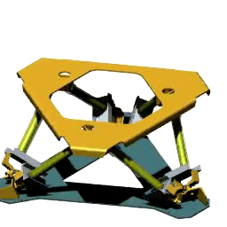
Virtual prototyping: video demo

Slide 36
Rapid Prototyping: Process Chain

Slide 37
Rapid prototyping: Process Chain

Slide 38
Rapid prototyping: Process Chain (continued…)
3D Modeling
Most time consuming step of the entire process chain
Interference studies, stress analyses, FEM analysis etc.
Data conversion and transmission
Conversion CAD data into .STL file format
Simplest and shortest step of the entire process chain
Checking and preparing
Defects due to improper modelling and/or file conversion
Repairing and optimizing 3D models
Slices the model into cross-sections of thickness ~ 0.12-0.5 mm
Building (mostly automated)
Post-processing (cleaning, post-curing, finishing etc.)

Slide 39
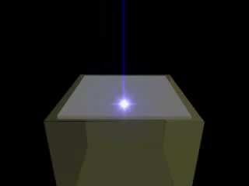
Rapid prototyping: video demo

Slide 40

3D Printing: How it happens?

Slide 41
Benefits of Rapid Manufacturing Technologies

Slide 42
Impact of rapid prototyping on product development
Direct benefits…
To the product designers
Can increase the product complexity
Need not concern about “manufacturability”
Can reduce parts count by combining features into a single-piece
Can minimize material and optimize strength/weight ratios

Slide 43
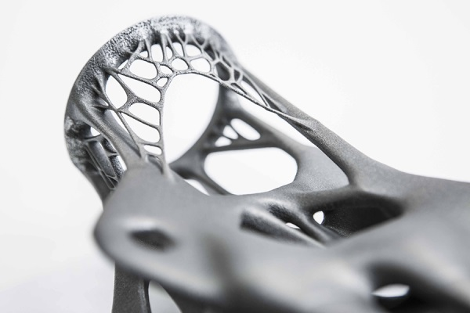
…Example:
Light-weight (but complex design) structures are possible due to 3D printing

Slide 44
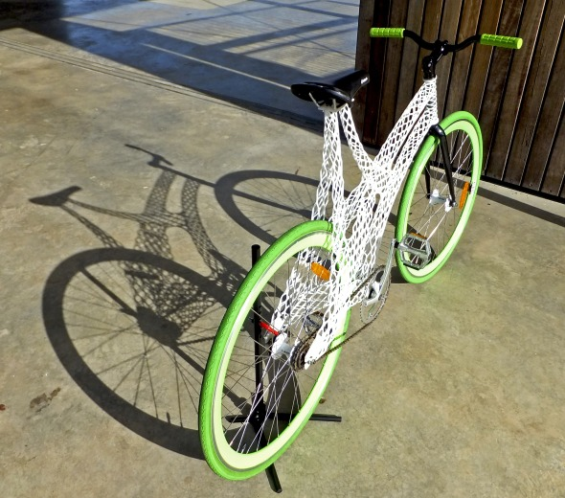
…Example:
Light-weight (but complex design) structures are possible due to 3D printing

Slide 45
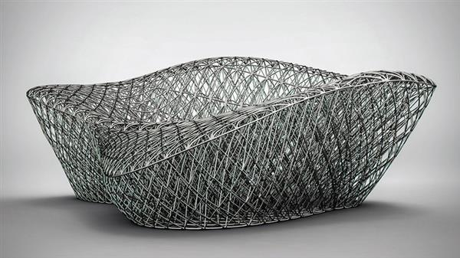
…Example:
Light-weight (but complex design) structures are possible due to 3D printing

Slide 46
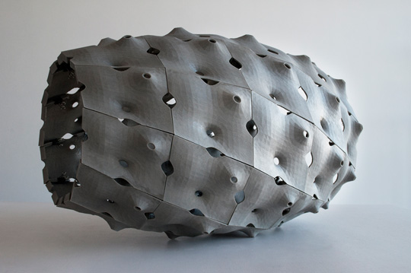
…Example:
Light-weight (but complex design) structures are possible due to 3D printing

Slide 47
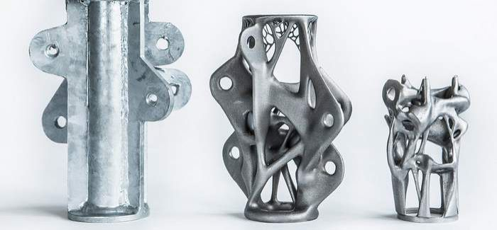
…Example:
Light-weight (but complex design) structures are possible due to 3D printing

Slide 48
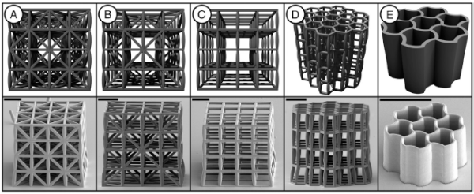
…Example:

Slide 49
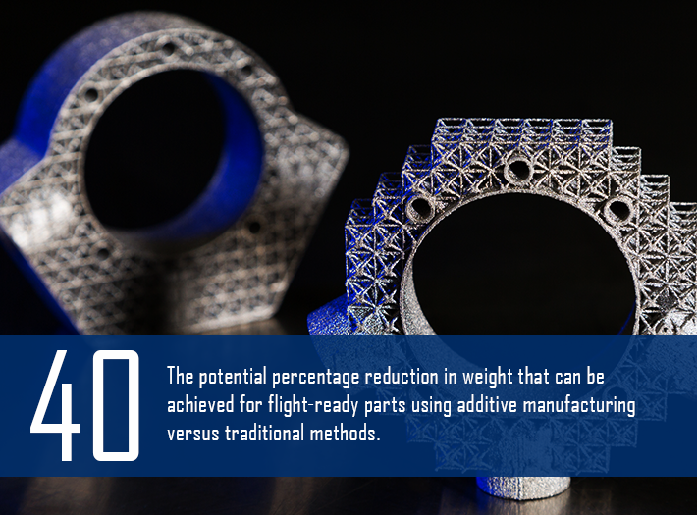
By the Numbers: 3-D Printing at Lockheed Martin

Slide 50
Impact of rapid prototyping on product development (contd..)
Direct benefits…
To the tooling and manufacturing engineer
The main savings are in costs
Can realize profits earlier on new products (since fixed costs are lower)
Assembly of the parts is easy and costs are lower (due to the reduced number of parts)
Less number of labour required
Reduced material wastage
Low inventory costs (Less inventory required)
General purpose machines can be used (leads to reduction in capital investment)
Scheduling the production is easy
Better and easy quality control

Slide 51
Impact of rapid prototyping on product development
In-direct benefits…
Benefits to Marketing
Adjust production lot dynamically based on the demand
No need to project future customer needs/market conditions
Products meet customer needs more closely
Can offer the latest technology to the customers
Can increase the diversity of the product offerings
Easy to expand and enter into new newer markets

Slide 52
Impact of rapid prototyping on product development
In-direct benefits…
Benefits to the consumer
Can buy products which meet individual needs and taste
Can buy customized products at affordable cost
Can get products at relatively cheaper rate due to the increased profitability to the manufacturer.

Slide 53
List of Few Common RP Technologies

Slide 54
RP Technologies

Slide 55
Rapid Tooling

Slide 56
Rapid tooling
Definitions:
Tooling:
The process of providing a factory with machinery in preparation for production.
Working or manufacturing aids such as cutting tools, dies, fixtures, gauges, jigs, molds, and patterns of a specialized nature which (unless substantially altered or modified) are limited in use to a specific production line or the performance of a specific contract or job
Rapid tooling:
The application of rapid prototyping technologies in the preparation of manufacturing tools.
A process which either uses a rapid prototyping (RP) model as a pattern to create a mold quickly or uses the Rapid Prototyping process directly to fabricate a tool for a limited volume

Slide 57
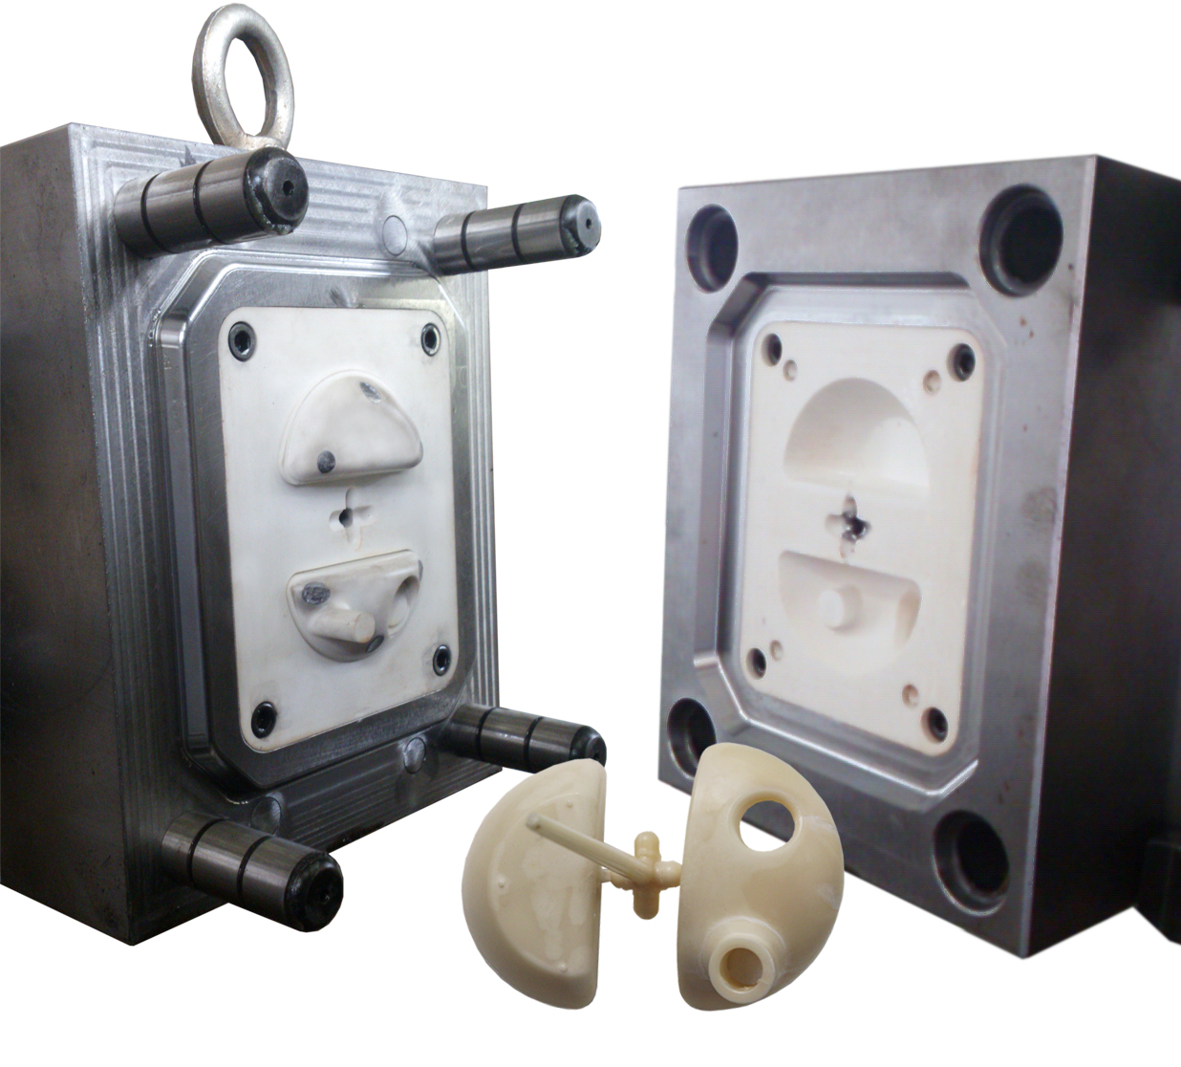
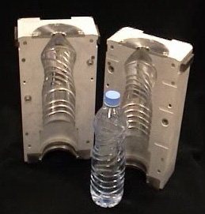
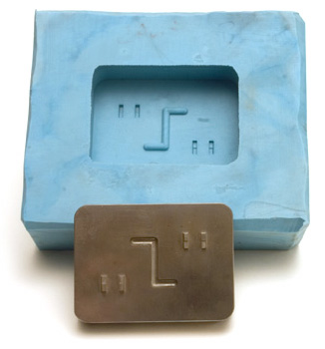
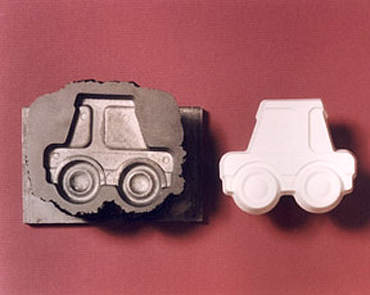
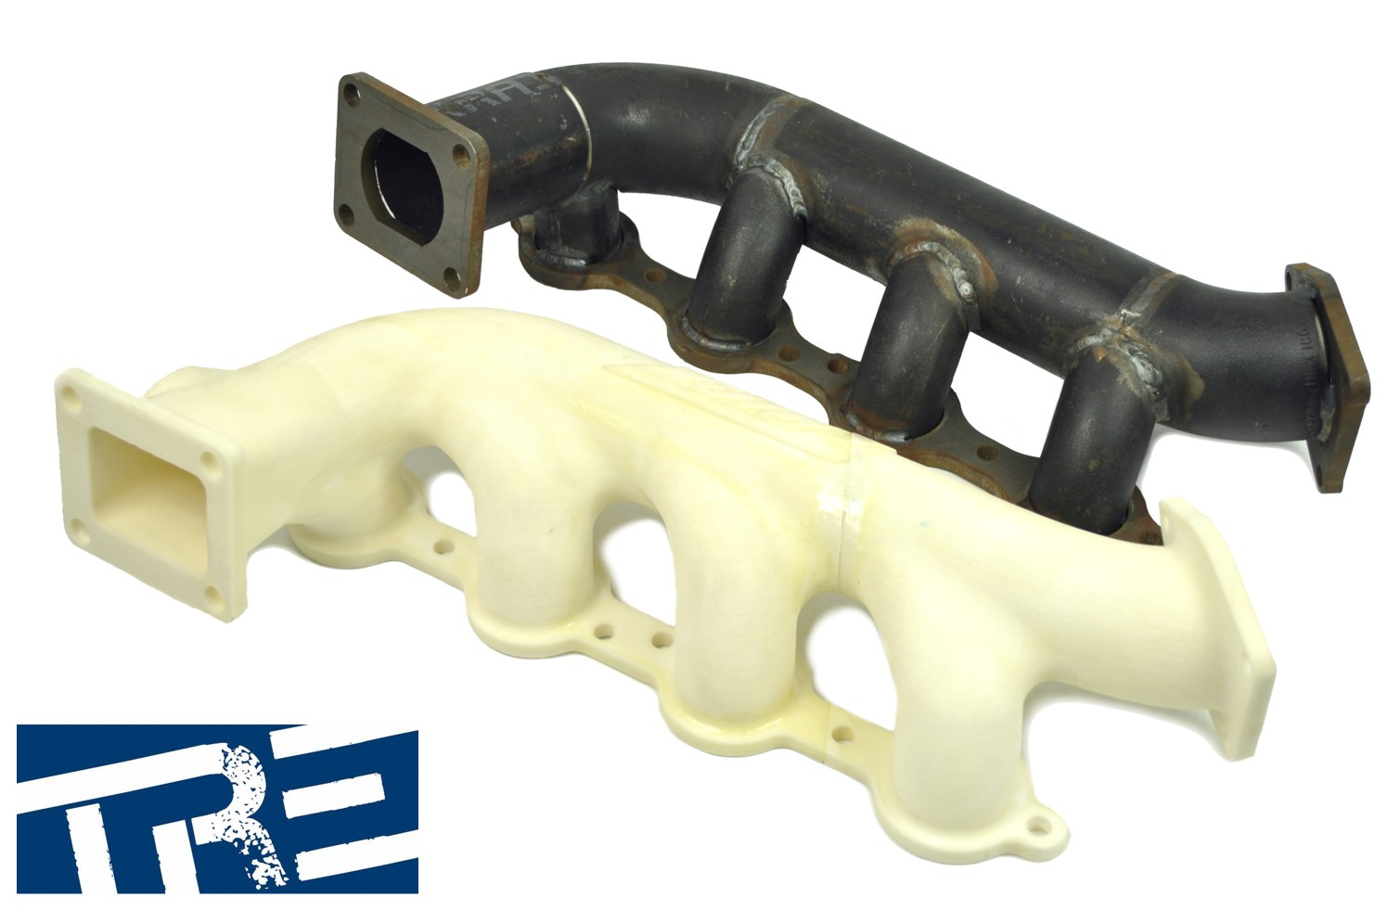
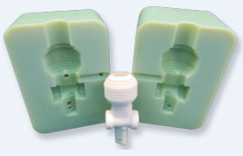
Rapid Tooling: Examples

Slide 58
Rapid Tooling
As Rapid Prototyping (RP) technology becomes more mature, it is beginning to lend itself to other applications such as rapid tooling and rapid manufacturing.
Some traditional tool making methods are considering the use of RP technologies to directly or indirectly fabricate tools.
The Indirect method of rapid tooling (RT) uses the RP pattern as mold.
This is considered as a good alternative to the traditional mold making since it is more efficient and requires less lead-time. This approach is also less expensive and allows for quick validation of designs.
Indirect RT method, the RP process is used for direct fabrication of the tools.

Slide 59
Rapid Tooling
In summary, rapid tooling is described as a process which uses an RP model as:
a pattern to create mold quickly (e.g. sand casting) or
uses the RP process directly to fabricate a limited volume of tools.
The theme of rapid tooling is the ability to produce multiple copies of a prototype with functional material properties in short lead times.

Slide 60
Rapid Tooling: Classification

Slide 61
Rapid tooling (Text book: Chua et al., Page No. 303-)

Slide 62
Rapid tooling (Text book: Chua et al., Page No. 303-)
Soft tooling
Typically made of silicone rubber, epoxy resins, low melting point alloys and foundry sands
Generally allows for only single casts or for small batch production runs
Hard tooling
Usually made from tool steels
Generally allows for longer production runs
Direct tooling: the tool or die is created directly by the RP process
Indirect methods: Use a pattern obtained by an appropriate RP technique as a model for mould and die making

Slide 63
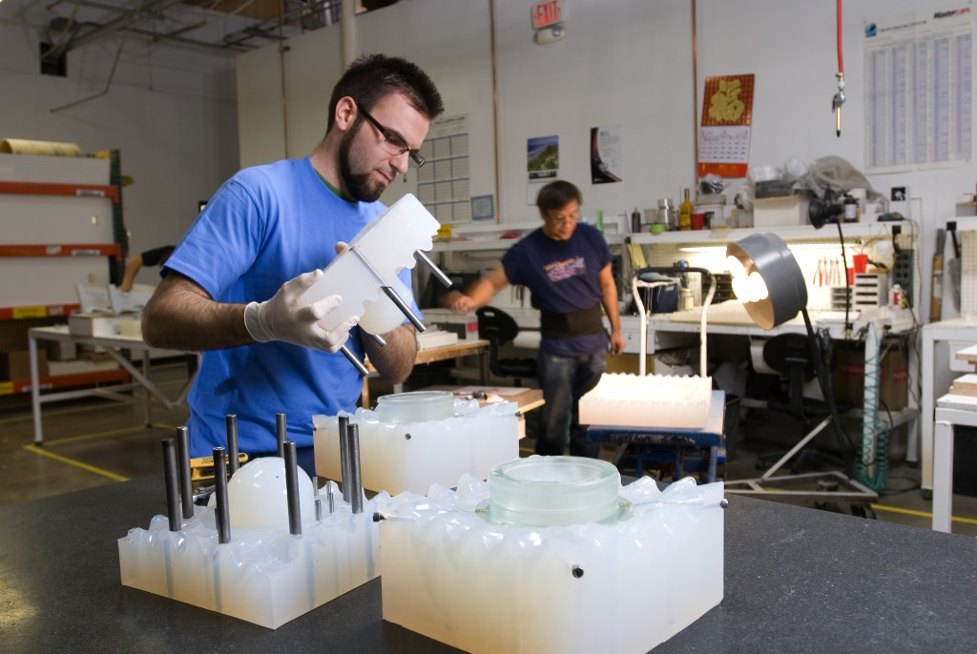
Soft tooling

Slide 64
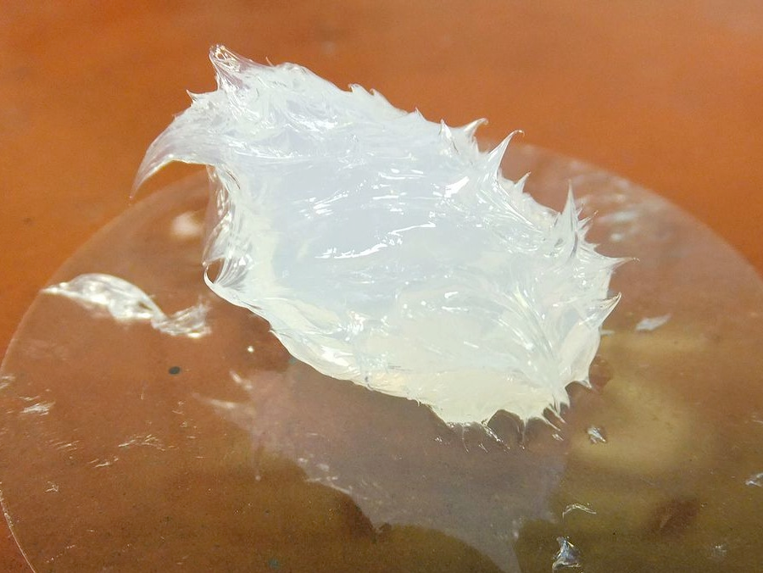
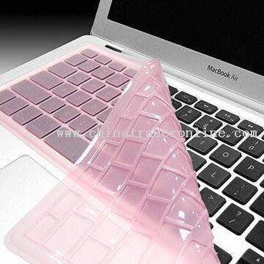
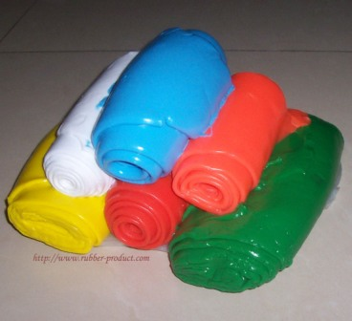
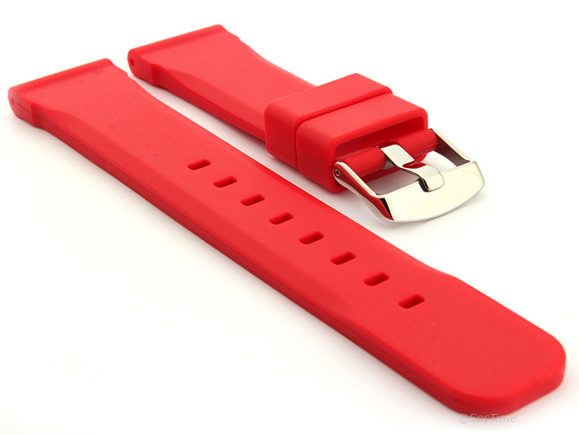
Example: silicone rubber can be used for soft tooling!

Slide 65
Applications of Rapid Manufacturing Technologies

Slide 66
Typical application areas of RP

Slide 67
Typical application areas of RP

Slide 68
Applications in Design
CAD Model Verification
This is the initial objective and strength of RP systems, in that designers often need the physical part to confirm the design that they have created in the CAD system.
This is especially important for parts or products designed to fulfil aesthetic functions or that are intricately designed to fulfil functional requirements.

Slide 69
Applications in Design
Visualizing Objects
Designs created on CAD systems need to be communicated not only amongst designers within the same team, but also to other departments, like manufacturing, and marketing.
Thus, there is a need to create objects from the CAD designs for visualization so that all these people will be referring to the same object in any communications.
“Many people cannot visualize a part by looking at print. Even engineers and toolmakers who deal with print everyday require several minutes or even hours of studying a print. Unfortunately, many of the people who approve a design (typically senior management, marketing analysts, and customers) have much less ability to understand a design by looking at a drawing.”
-Tom Mueller

Slide 70
Applications in Design
Proof of Concept
Proof of concept relates to the adaptation, of specific details to an object environment or aesthetic aspects (such as car telephone in a specific car), or of specific details of the design on the functional performance of a desired task or purpose.

Slide 71
Marketing and Commercial Applications
Frequently, the marketing or commercial departments require a physical model for presentation and evaluation purposes, especially for assessment of the project as a whole. The mock-up or presentation model can even be used to produce promotional brochures and related materials for marketing and advertising even before the actual product becomes available.

Slide 72
Applications in Engineering, Analysis and Planning
Scaling
RP technology allows easy scaling down (or up) of the size of a model by scaling the original CAD model.
Example: In a case of designing bottles for perfumes with different holding capacities, the designer can simply scale the CAD model appropriately for the desired capacities

Slide 73
Applications in Engineering, Analysis and Planning
2. Form and Fit
Other than dealing with sizes and volumes, forms have to be considered from the aesthetics and functional standpoint as well. How a part fits into a design and its environment are important aspects, which have to be addressed.
For example, the wing mirror housing for a new car design has to have the form that augments well with the general appearance of the exterior design. This will also include how it fits to the car door. The model will be used to evaluate how it satisfies both aesthetic and functional requirements.
Form and fit models are used not just in the automotive industries. They can also be used for industries involved in aerospace and others like consumer electronic products and appliances.

Slide 74
Applications in Engineering, Analysis and Planning
3. Flow Analysis
Experiments with 3D physical models are frequently required to study product performance in air and liquid flow.
Such models can be easily built using RP technology.
Modifications in design can be done on computer and rebuilt for re-testing very much faster than using traditional prototyping methods.
Flow analyses are also useful for studying the inner sections of inlet manifolds, exhaust pipes, replacement heart valves, or similar products that at times can have rather complex internal geometries.

Slide 75
Applications in Engineering, Analysis and Planning
4. Stress Analysis
In stress analysis using mechanical or photo-optical methods or otherwise, physical replicas of the part being analyzed are necessary.
If the material properties or features of the RP technologies generated objects are similar to those of the actual functional parts, they can be used in these analytical methods to determine the stress distribution of the product.

Slide 76
Applications in Engineering, Analysis and Planning
5. Mock-Up Parts
“Mock-up” parts, a term first introduced in the aircraft industry, are used for final testing of different aspects of the parts. Generally, mockup parts are assembled into the complete product and functionally tested at pre-determined conditions, e.g., for fatigue.
Some RP techniques are able to generate “mock-ups” very quickly to fulfil these functional tests before the design is finalized.

Slide 77
Applications in Engineering, Analysis and Planning
6. Pre-Production Parts
The necessary accessory equipment, such as fixtures, chucks, special tools and measurement devices required for the mass-production process are prepared and checked.
Many of the RP methods are able to quickly produce pilot-production parts, thus helping to shorten the process development time, thereby accelerating the overall time-to-market process.

Slide 78
Applications in Engineering, Analysis and Planning
7. Diagnostic and Surgical Operation Planning
In combining engineering prototyping methodologies with surgical procedures, RP models can complement various imaging systems, such as magnetic resonance imaging (MRI) and computed tomography (CT) scanning, to produce anatomical models for diagnostic purposes.
These RP models can also be used for surgical and reconstruction operation planning.
This is especially useful in surgical procedures that have to be carried out by different teams of medical specialists and where interdepartmental communication is of essence.

Slide 79
Applications in Engineering, Analysis and Planning
8. Design and Fabrication of Custom Prosthesis and Implant
RP can be applied to the design and fabrication of customized prostheses and implants.
A prosthesis or implant can be made from anatomical data inputs from imaging systems, e.g., laser scanning and computed tomography (CT).
In cases, such as having to produce ear prostheses, a scan profile can be taken of the good ear to create a computer-mirrored exact replica replacement using RP technology.
These models can be further refined and processed to create the actual prostheses or implants to be used directly on a patient.
The ability to efficiently customize and produce such prostheses and implants is important, as standard sizes are not always an ideal fit for the patient.

Slide 80
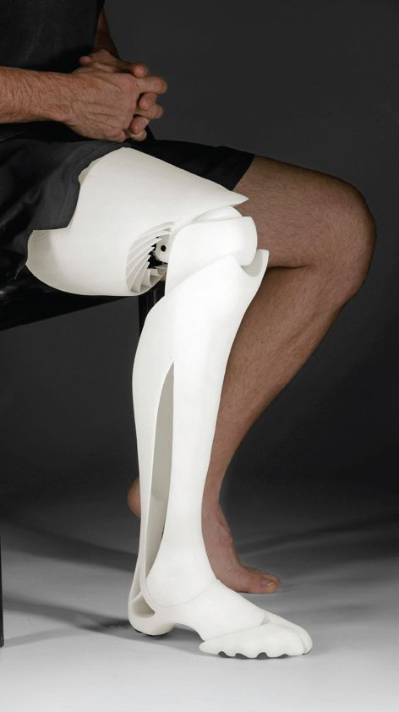
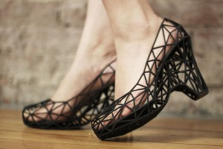

General Examples
An example of 3D printing used to create these shoes.
3D Printed Leg
Human skin created from stem cells using a 3D printer
Courtesy: SPI Lasers

Slide 81
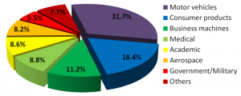
Spread of rapid prototyping by industry worldwide
Courtesy: SPI Lasers

